Slide 1



What is ivory?
Ivory is a hard, white material from the tusks and teeth of certain mammals, such as an elephant.
What other mammals do you think have ivory tusks or teeth?
Tusks

Slide 2
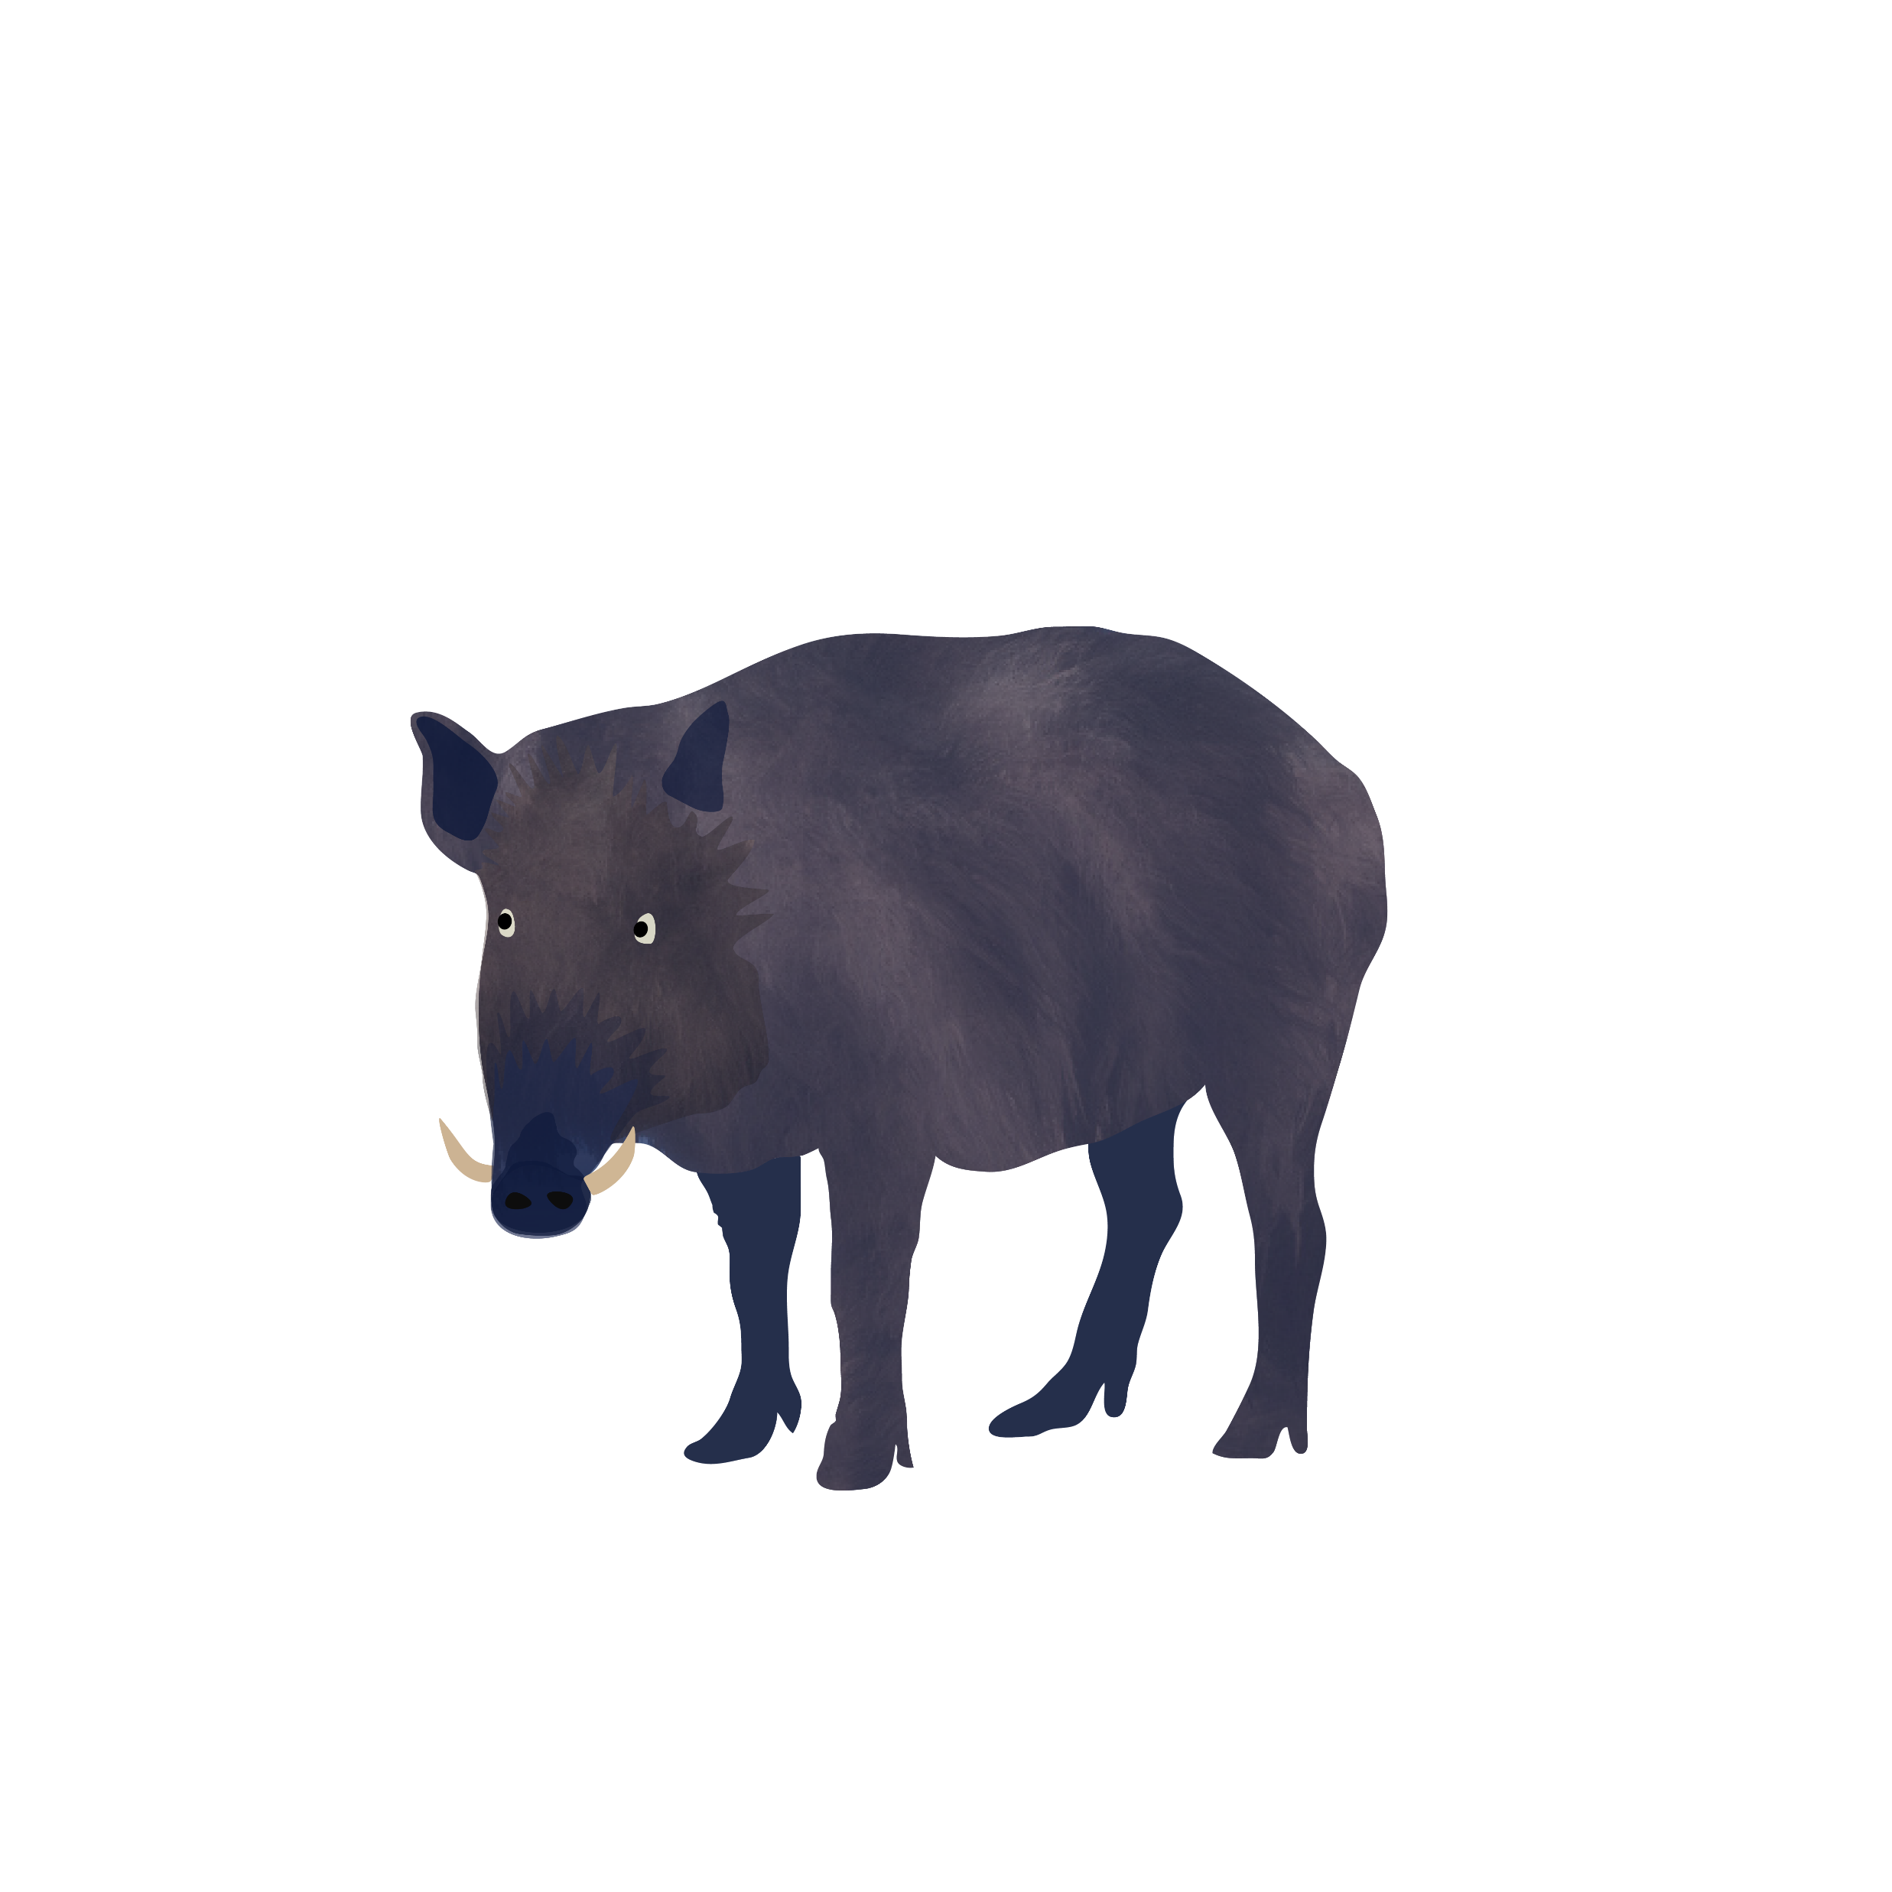
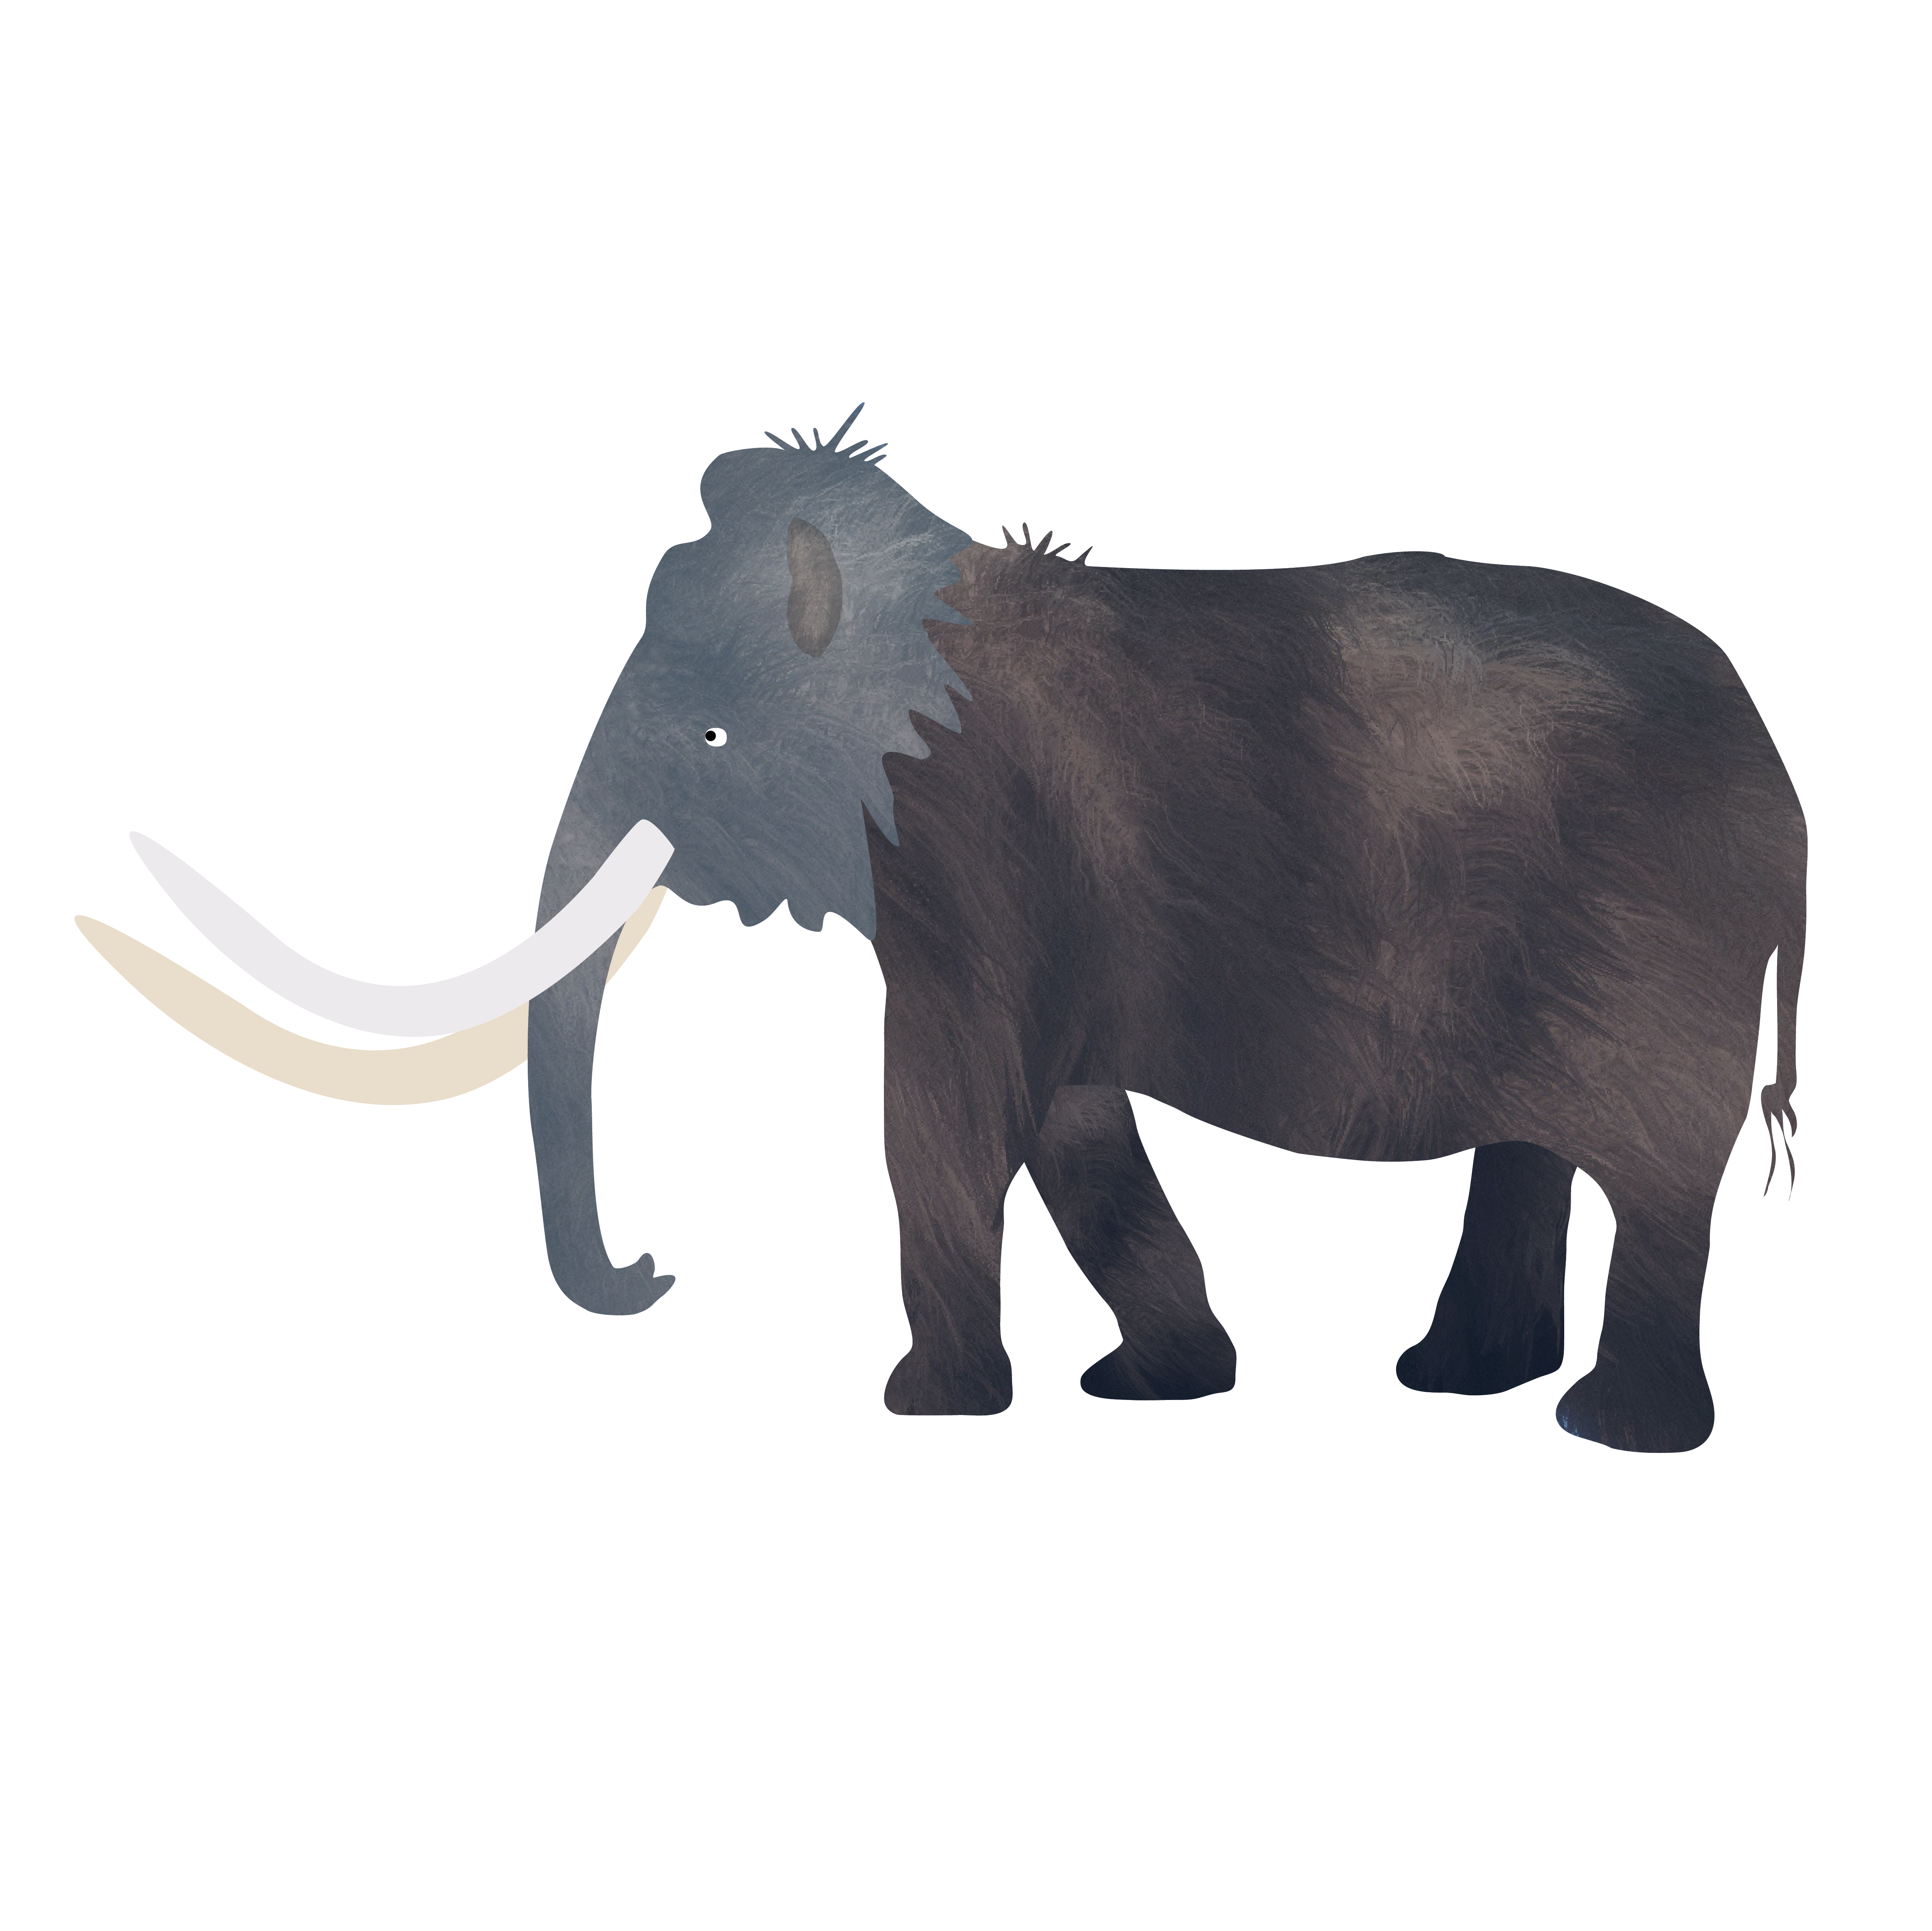
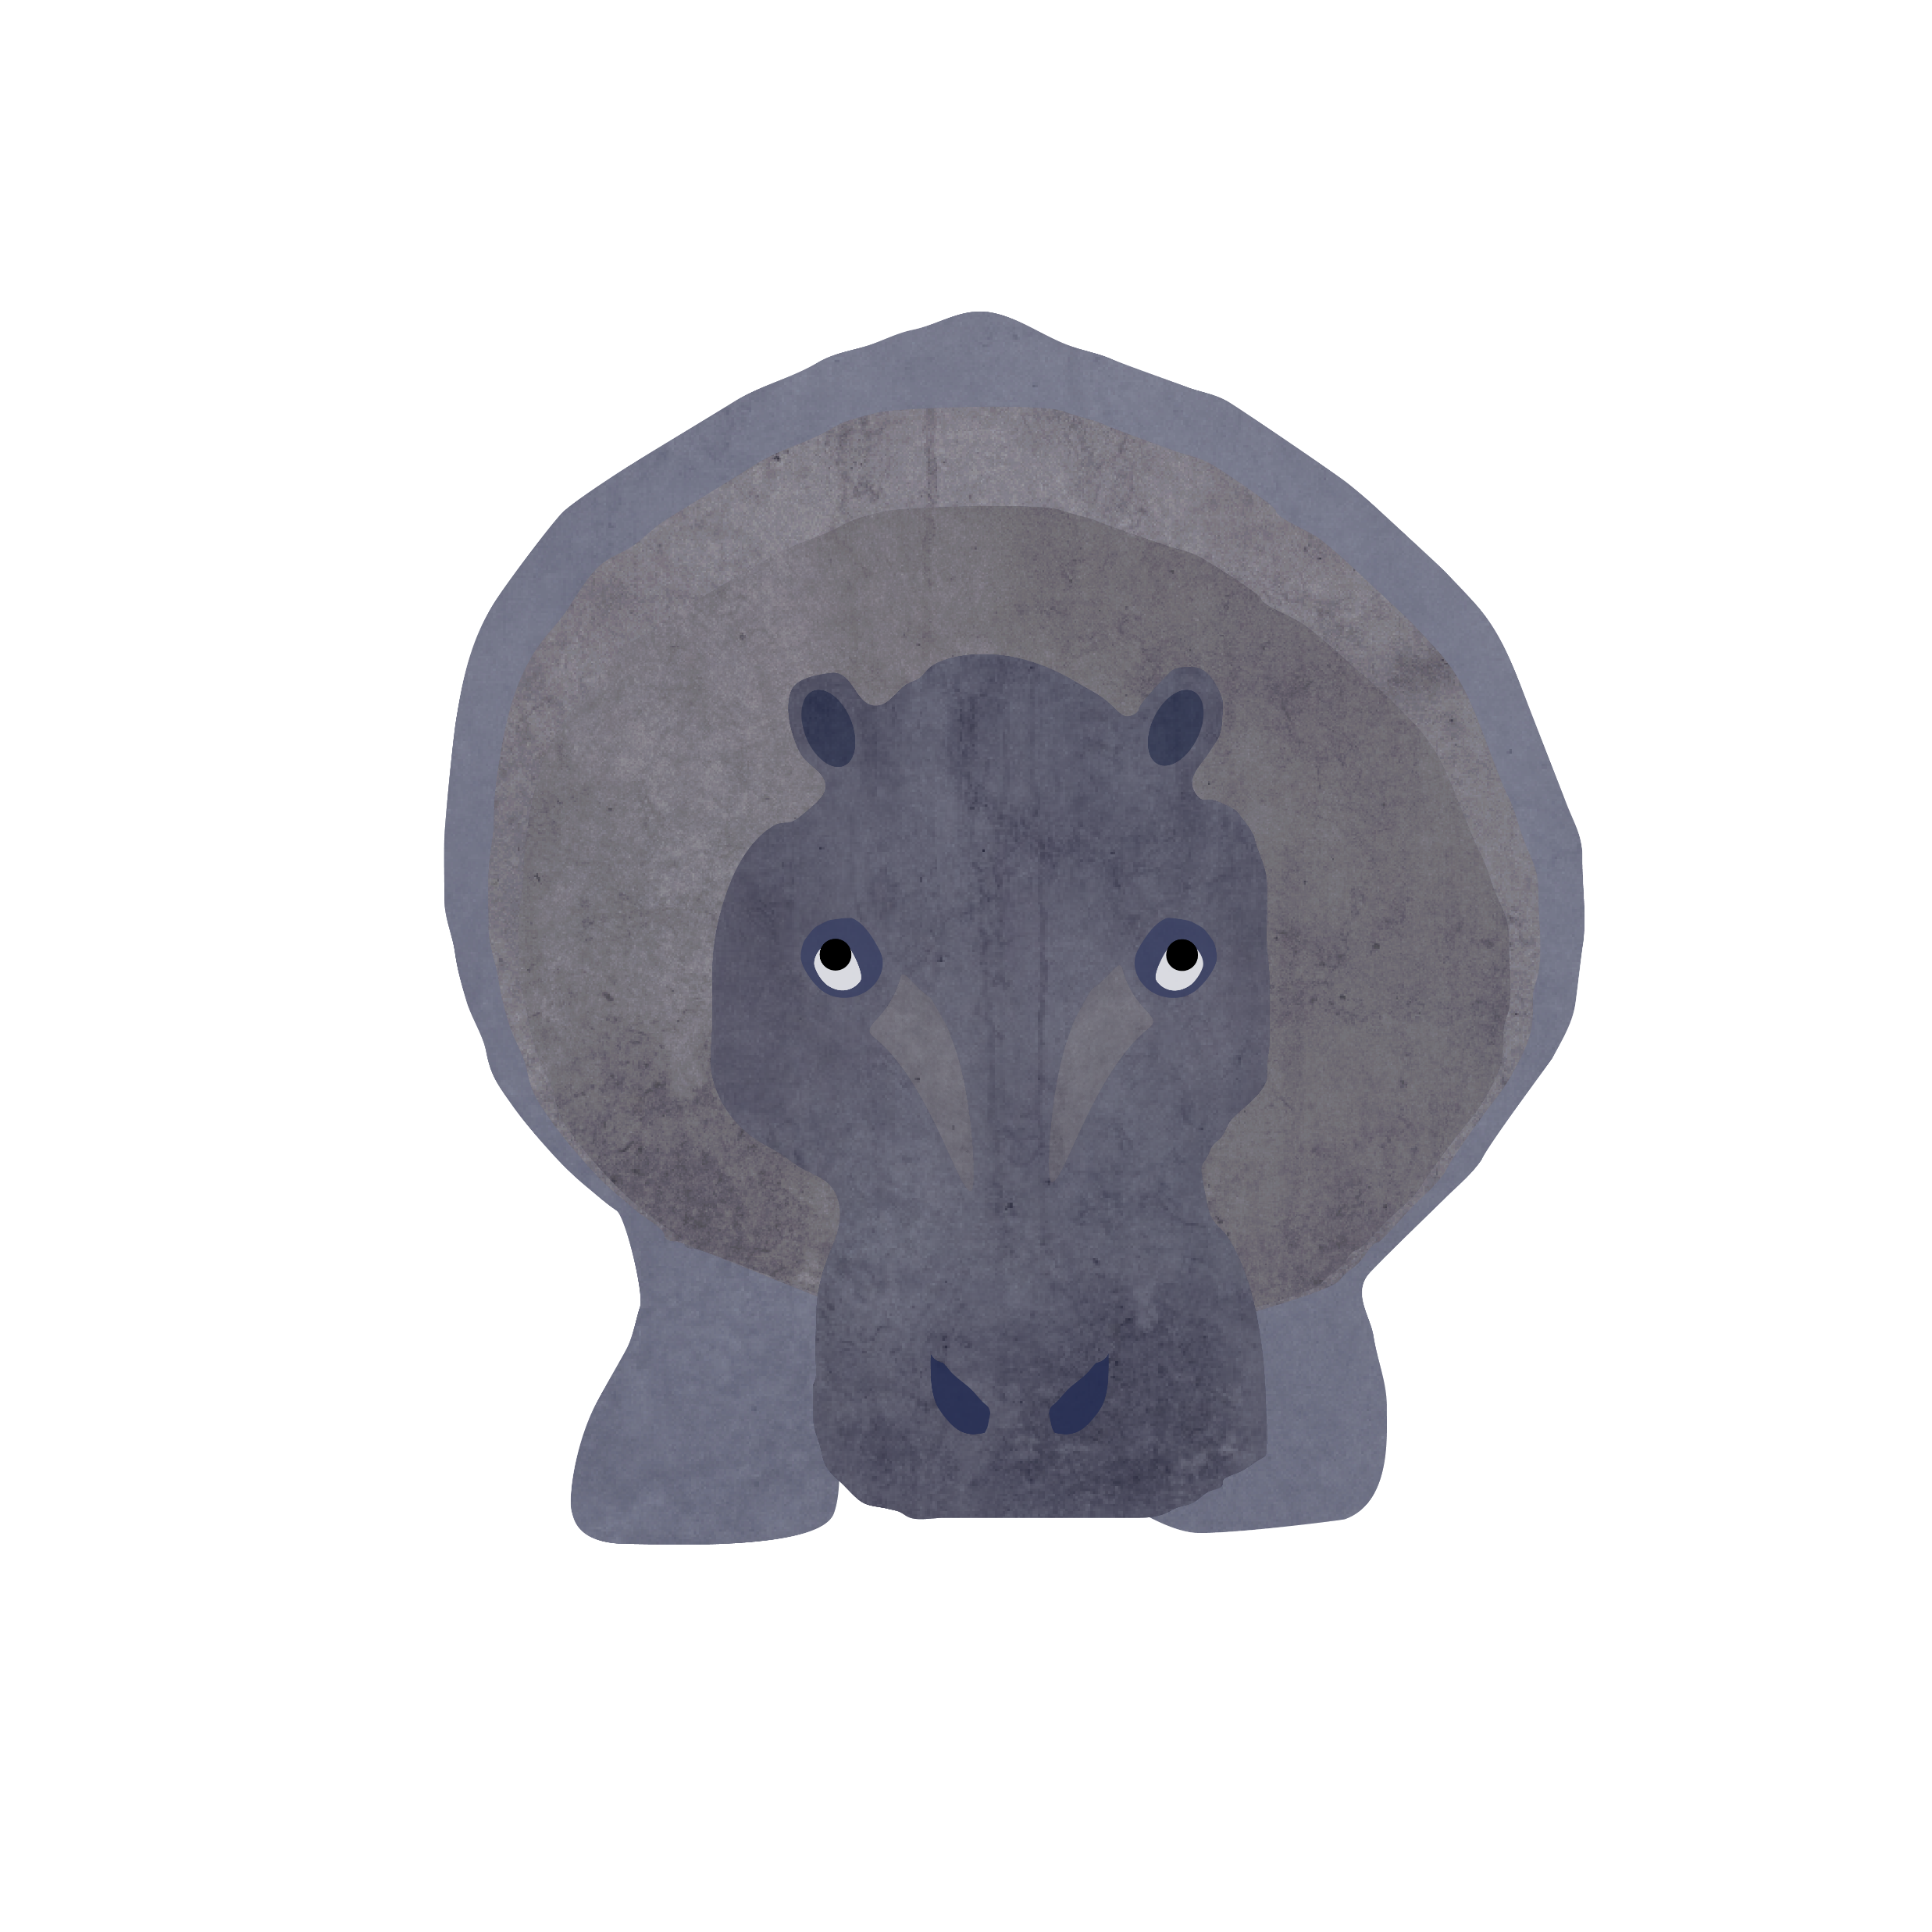
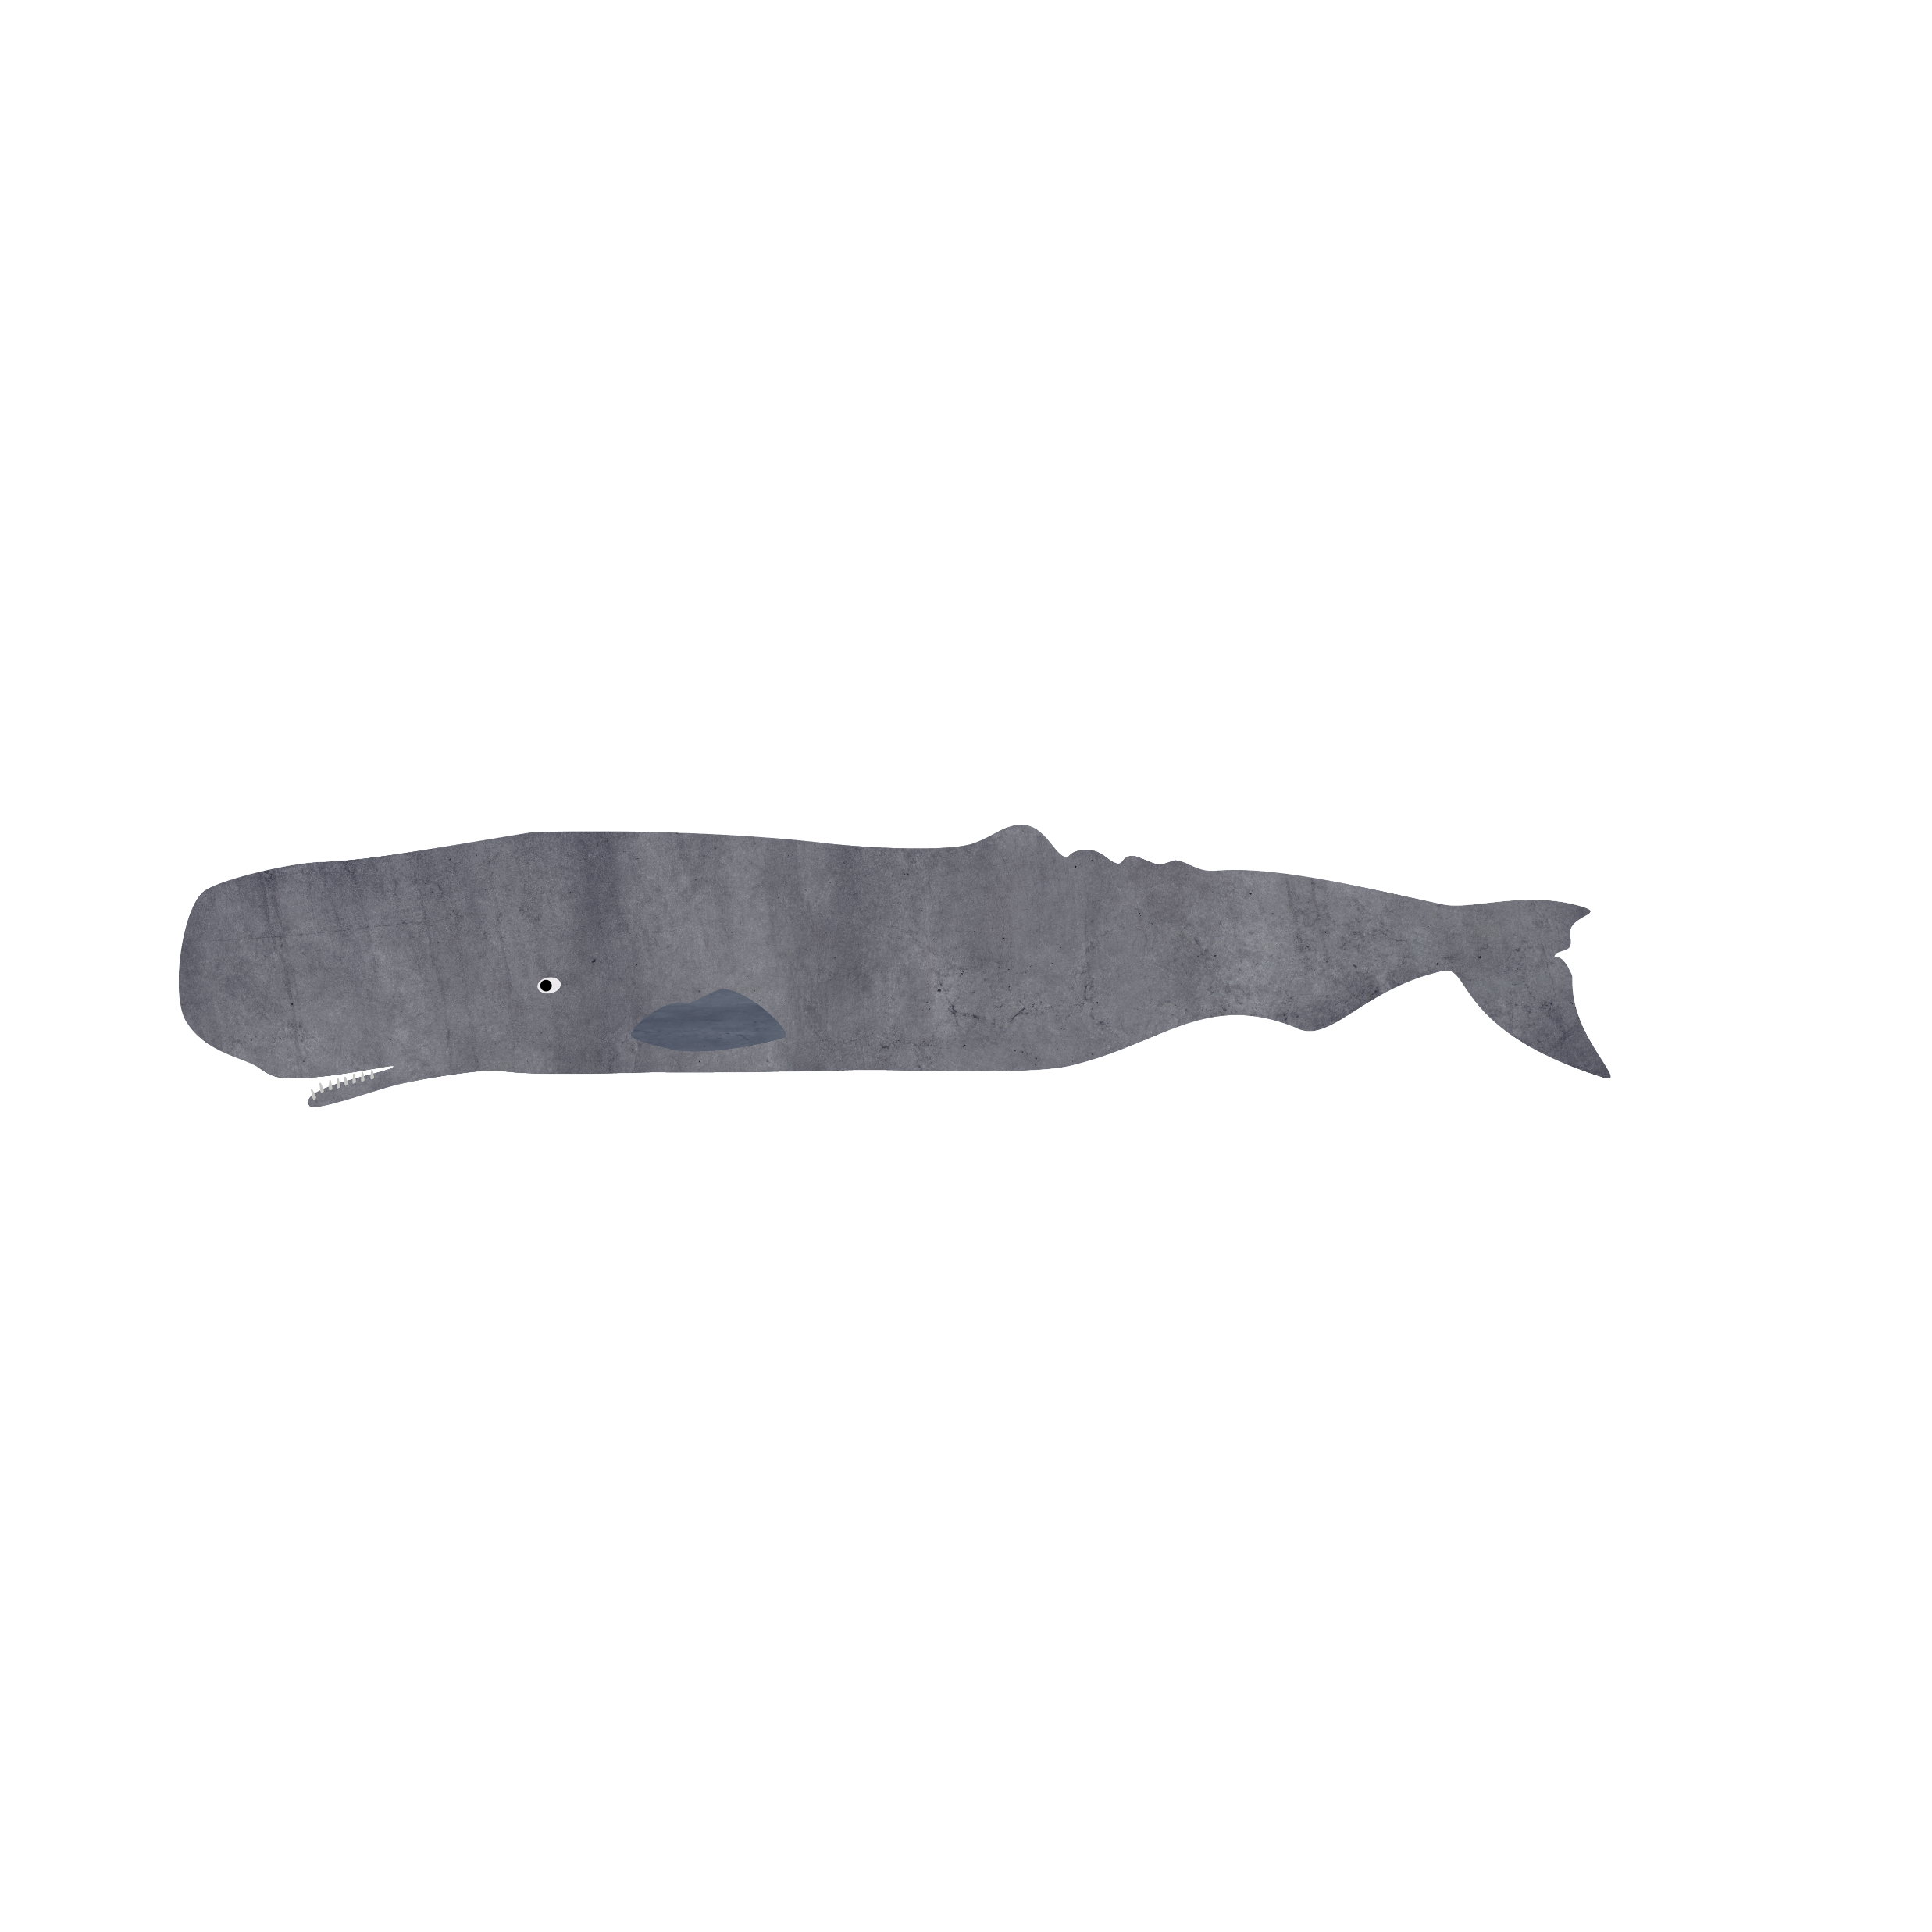
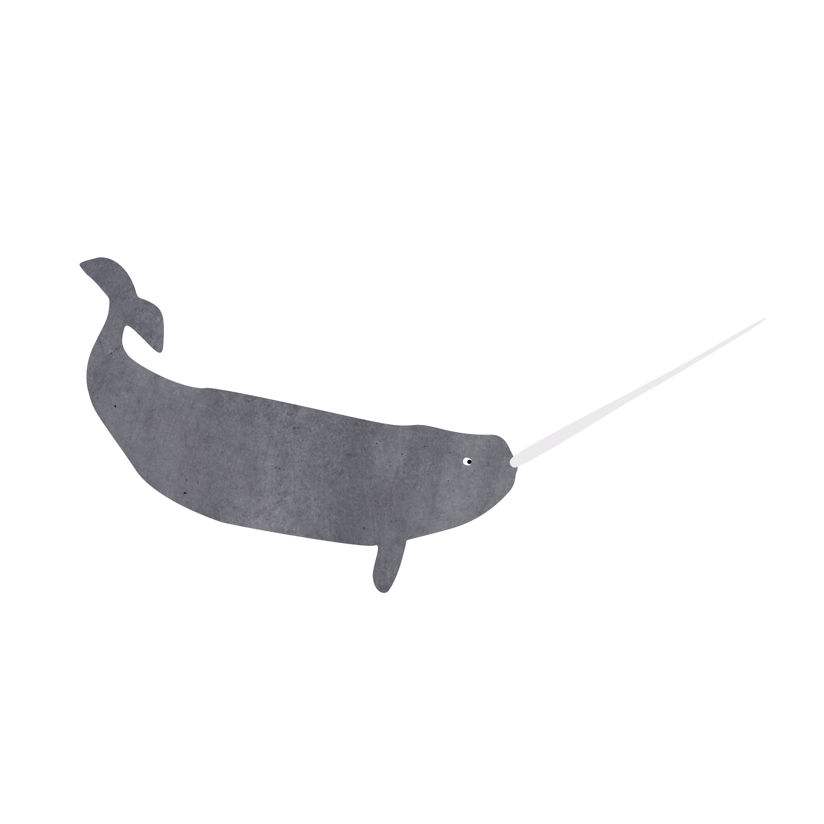
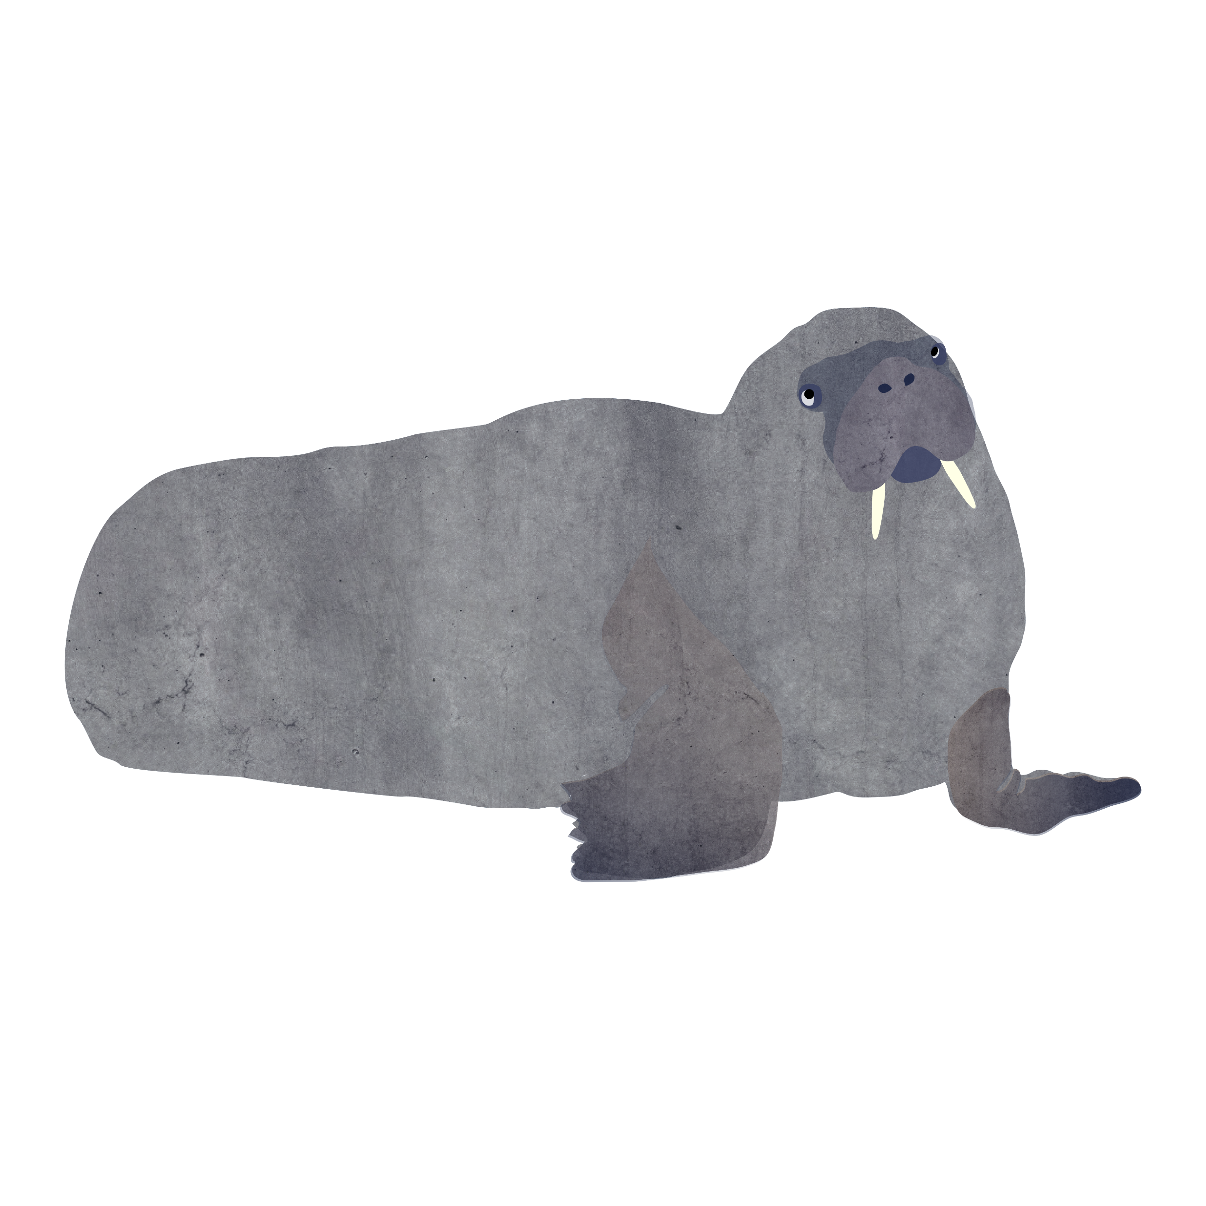
What mammals have ivory teeth and tusks?
Wild Boar
Mammoth
Hippo
Elephant
Sperm Whale
Narwhal
Walrus
Which is the odd one out?

Slide 3
Answer: Mammoth – as they are extinct.
Mammoths are now extinct but their tusks keep appearing in the Arctic as the permafrost melts due to global warming. It is legal to carve and sell mammoth tusks as no animal is killed in the process.

Slide 4
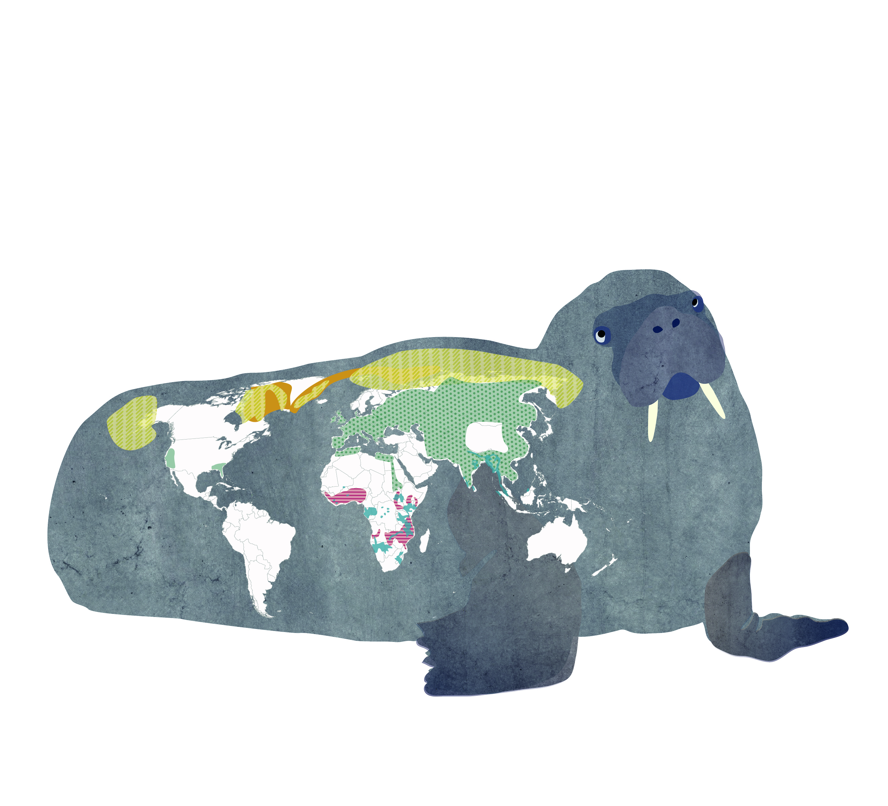
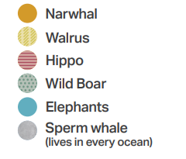
Where do mammals with ivory tusks and teeth live?

Slide 5
Why do mammals have tusks?
Fighting
Land mammals use tusks for digging for food
Elephants use their tusks for knocking down trees and stripping bark off
Walruses use their tusks for keeping breathing holes in the ice open, and for helping them get out of the water
Narwhals use their tusk as a sensory organ (much like your nose!). The tusk can sense how salty the water is and how warm or cold it is. The narwhal tusk is the only mammal tooth that can constantly sense their environment.

Slide 6
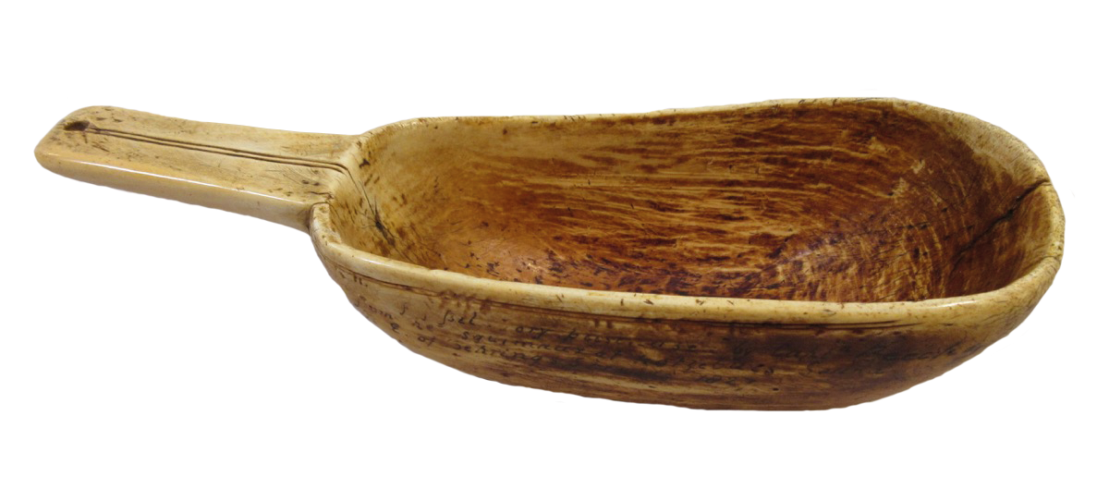
Why have humans used ivory to make objects ?
In the past humans used ivory to make many different kinds of objects from everyday to luxury items. They used this material because……
It was once widely available in several environments
It is valuable (mammals only have up to two tusks and a certain number of teeth)
Ivory is an amazing material – smooth, tough and beautiful!
Scoop made from mammoth ivory by Inuit people, North America

Slide 7
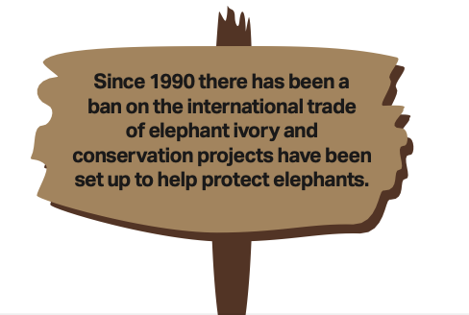
Consequences
Killing animals for their ivory tusks and teeth has led to a decline in numbers of many of these mammals. Now there are strict rules in place relating to the hunting and trading of mammals with ivory.
Elephants are endangered as they were hunted with guns in the 19th century for their ivory tusks. The ivory was used as a raw material to make everyday objects like games and cutlery handles.
Now ivory has been replaced by materials like plastic but elephants are still killed illegally for their tusks.

Slide 8
Once a widely available material……
In the past ivory used to be more available than wood in the Arctic as trees struggle to grow in very cold places.
Inuit people used tusks from walruses and narwhals to make essential objects. What sort of objects do you think the Inuit people made from ivory?
Inuit people didn’t just use the tusks of the animals to make objects they needed, they used every part. They might use blubber for oil, flesh for food and bones for tools.
In this harsh environment being able to hunt and use every part of an animal was a matter of survival.

Slide 9
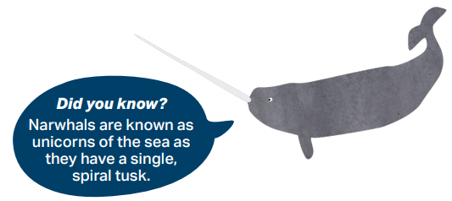
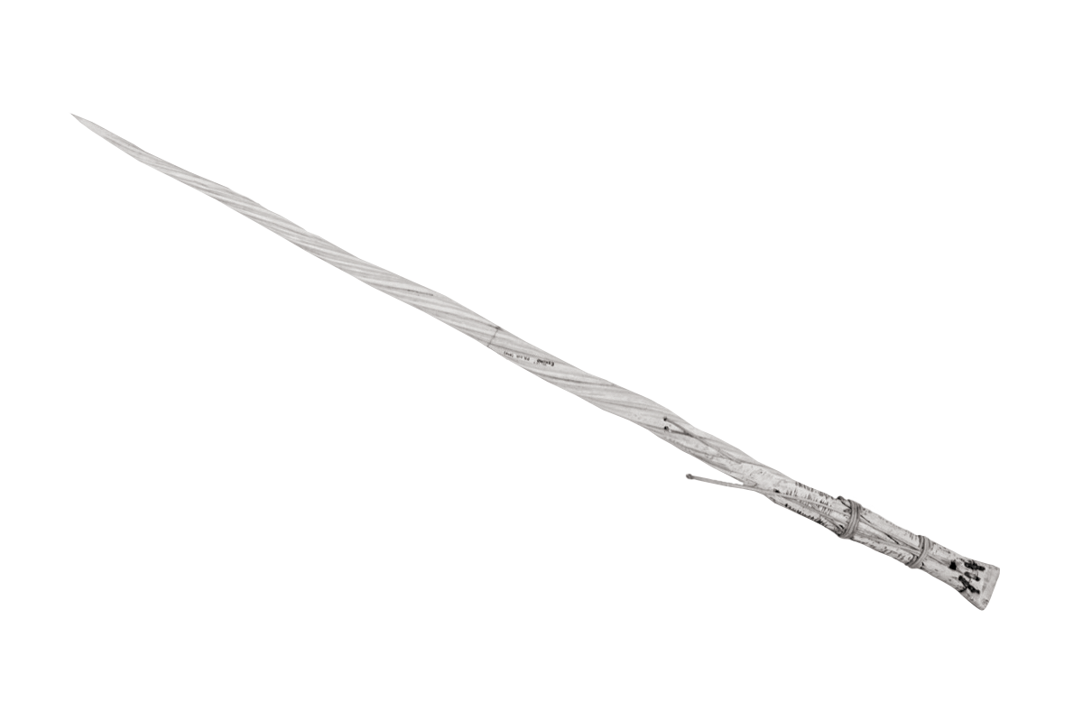
Narwhal Tusks
What do you think this narwhal tusk was used for by Inuit people in the past ?

Slide 10
Answer: A hunting spear!
Narwhal tusks could also be used as:
A tent pole
A tool to lever up sledges stuck on the snow!

Slide 11
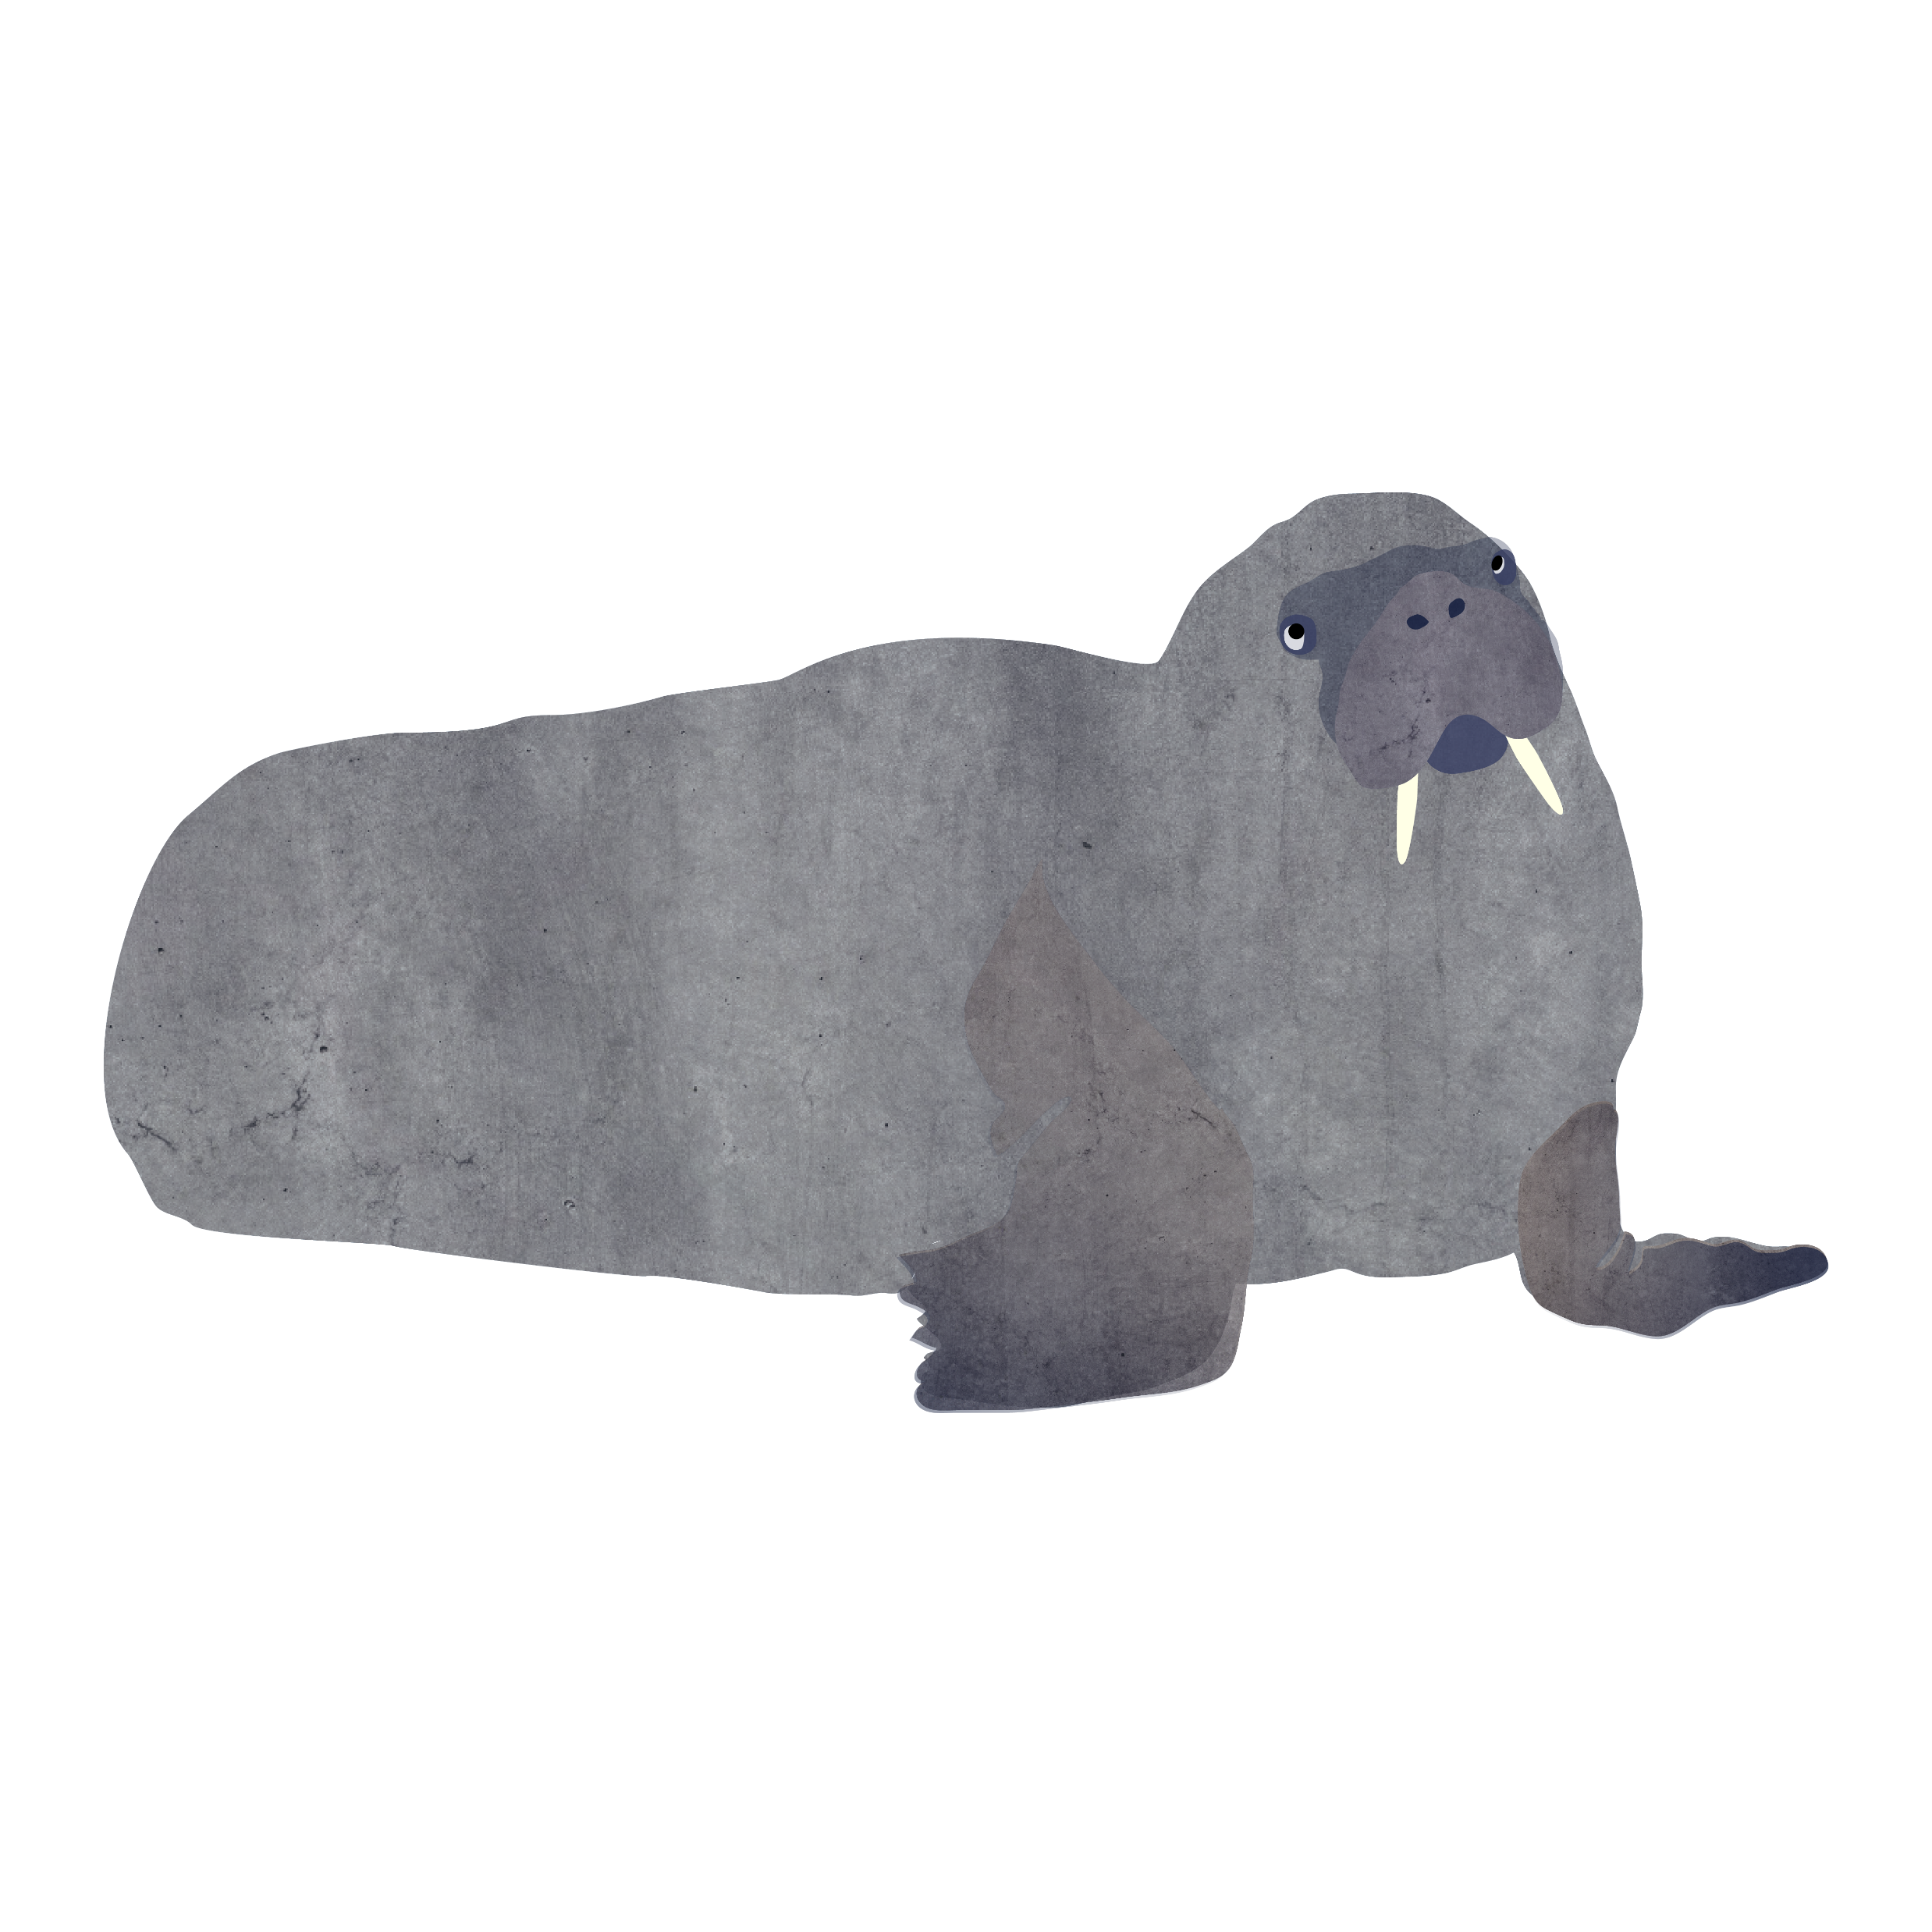
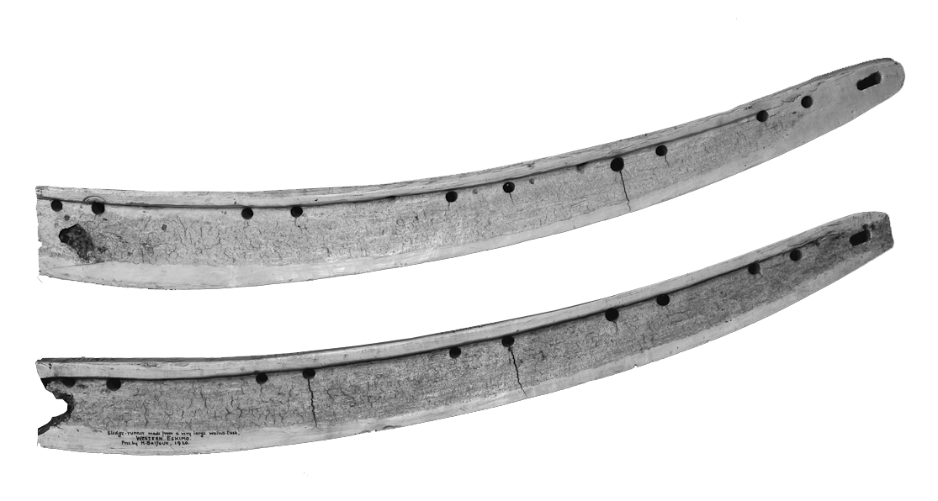
Walrus Tusks
What do you think these walrus tusks were used for by the Inuit people in the past?
Answer………..
Sledge runners. You can see the holes where they have been tied onto the sledge.
The fact that ivory is so tough and smooth makes it ideal for running across snow and ice.
Did you know?
Inuit communities in the Arctic regions of Canada and Greenland are allowed to hunt a certain amount of narwhals and walrus each year. They use the animals for food and make objects from ivory and bone as part of the sustainable use of these animals in Arctic waters.

Slide 12

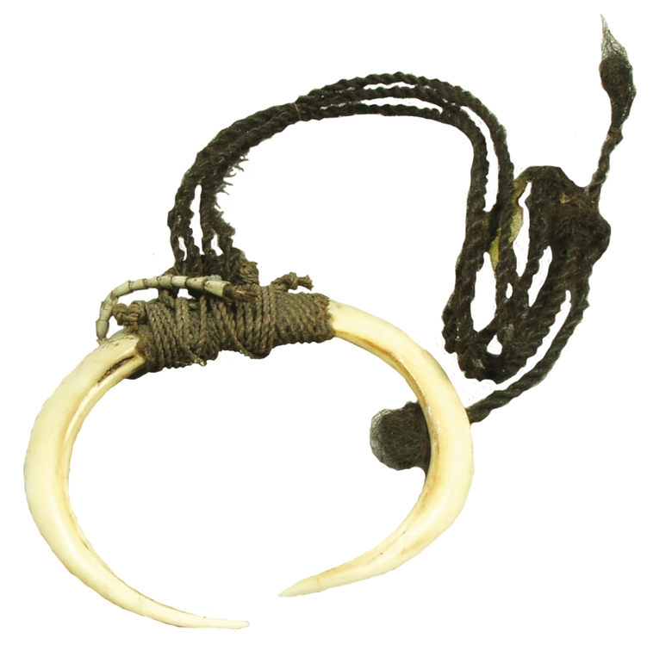
Look at me – I’m important
Ivory has often been used to make objects as it is a valuable material and can show that someone is important. As mammals have a limited number of tusks and teeth it increases the value of the material.
Look at the boar tusk necklace from Papua New Guinea. Necklaces made from boar tusks were worn by male warriors to show that they were powerful and fierce like boars.
What animal would you like to be linked with and why?

Slide 13
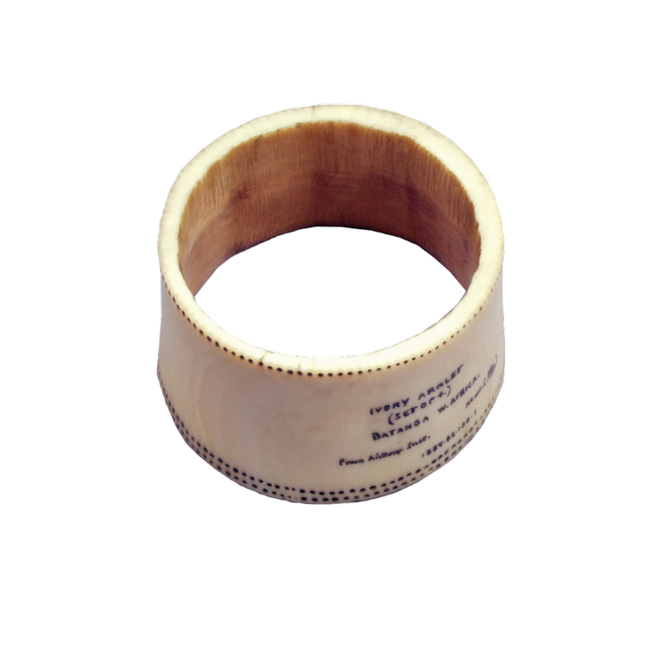
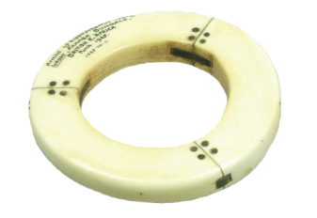
Look at me – I’m important
Armlets made from elephant ivory were often worn in West and Central African communities to show that someone was important.
Armlets made from hippo ivory were worn by the Kamba people in Kenya to show that someone was wealthy and a good hunter.
What might someone wear now to show they are wealthy or brave?

Slide 14
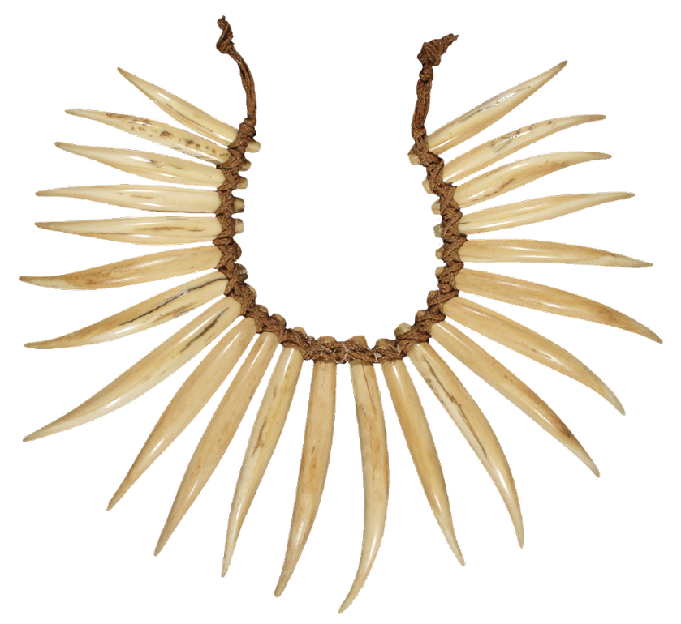
Look at me – I’m important
Look at this necklace made from sperm whale’s teeth from the Pacific island of Fiji.
On Fiji, only a chief can wear a tooth necklace on special occasions.
Think of leaders in your own community – Kings, Queens, headteachers…….
What do they wear at special occasions?

Slide 15
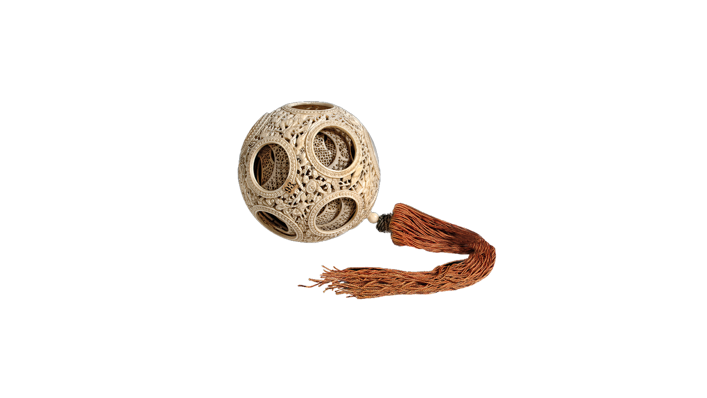
Amazing Material
Ivory is a tough material which lasts a long time – mammals need their teeth and tusks to be strong for eating, digging, and fighting. Many everyday objects were made from ivory in the Arctic as Inuit people knew this material would last.
Ivory is a fabulous material for carving objects from– it is hard, long-lasting, smooth and polished by oils from human hands over time.
Did you know? Puzzle balls were made in China for hundreds of years to hang inside the house. The way to solve the puzzle was to line up all of the balls inside so you could fit a small stick through the centre of them all.
Scoop made from mammoth ivory by Inuit people, North America
Puzzle ball from China made from a solid piece of elephant ivory

Slide 16
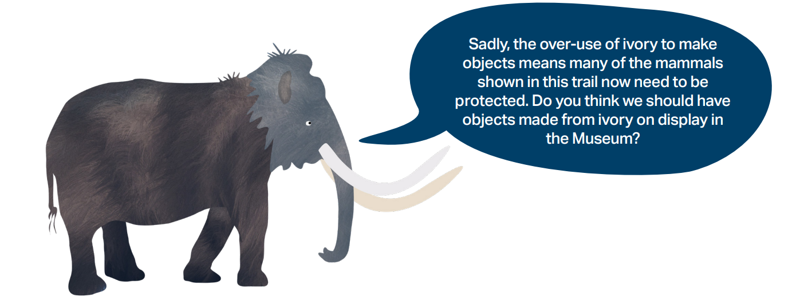
Situation Today

